Slide 1

CLICK HERE

Slide 2



Slide 3
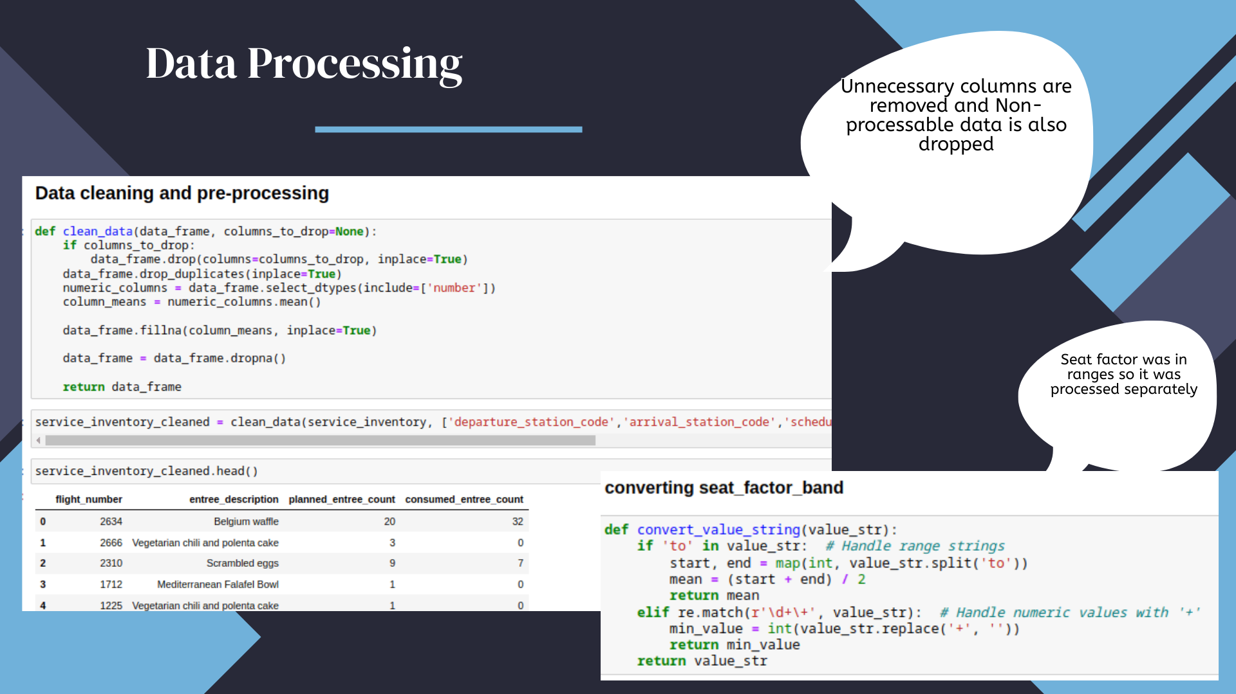

Slide 4
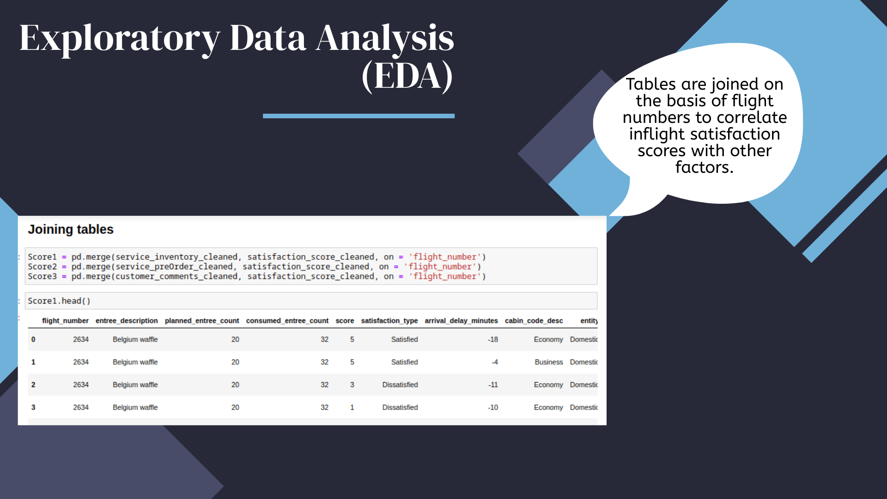

Slide 5
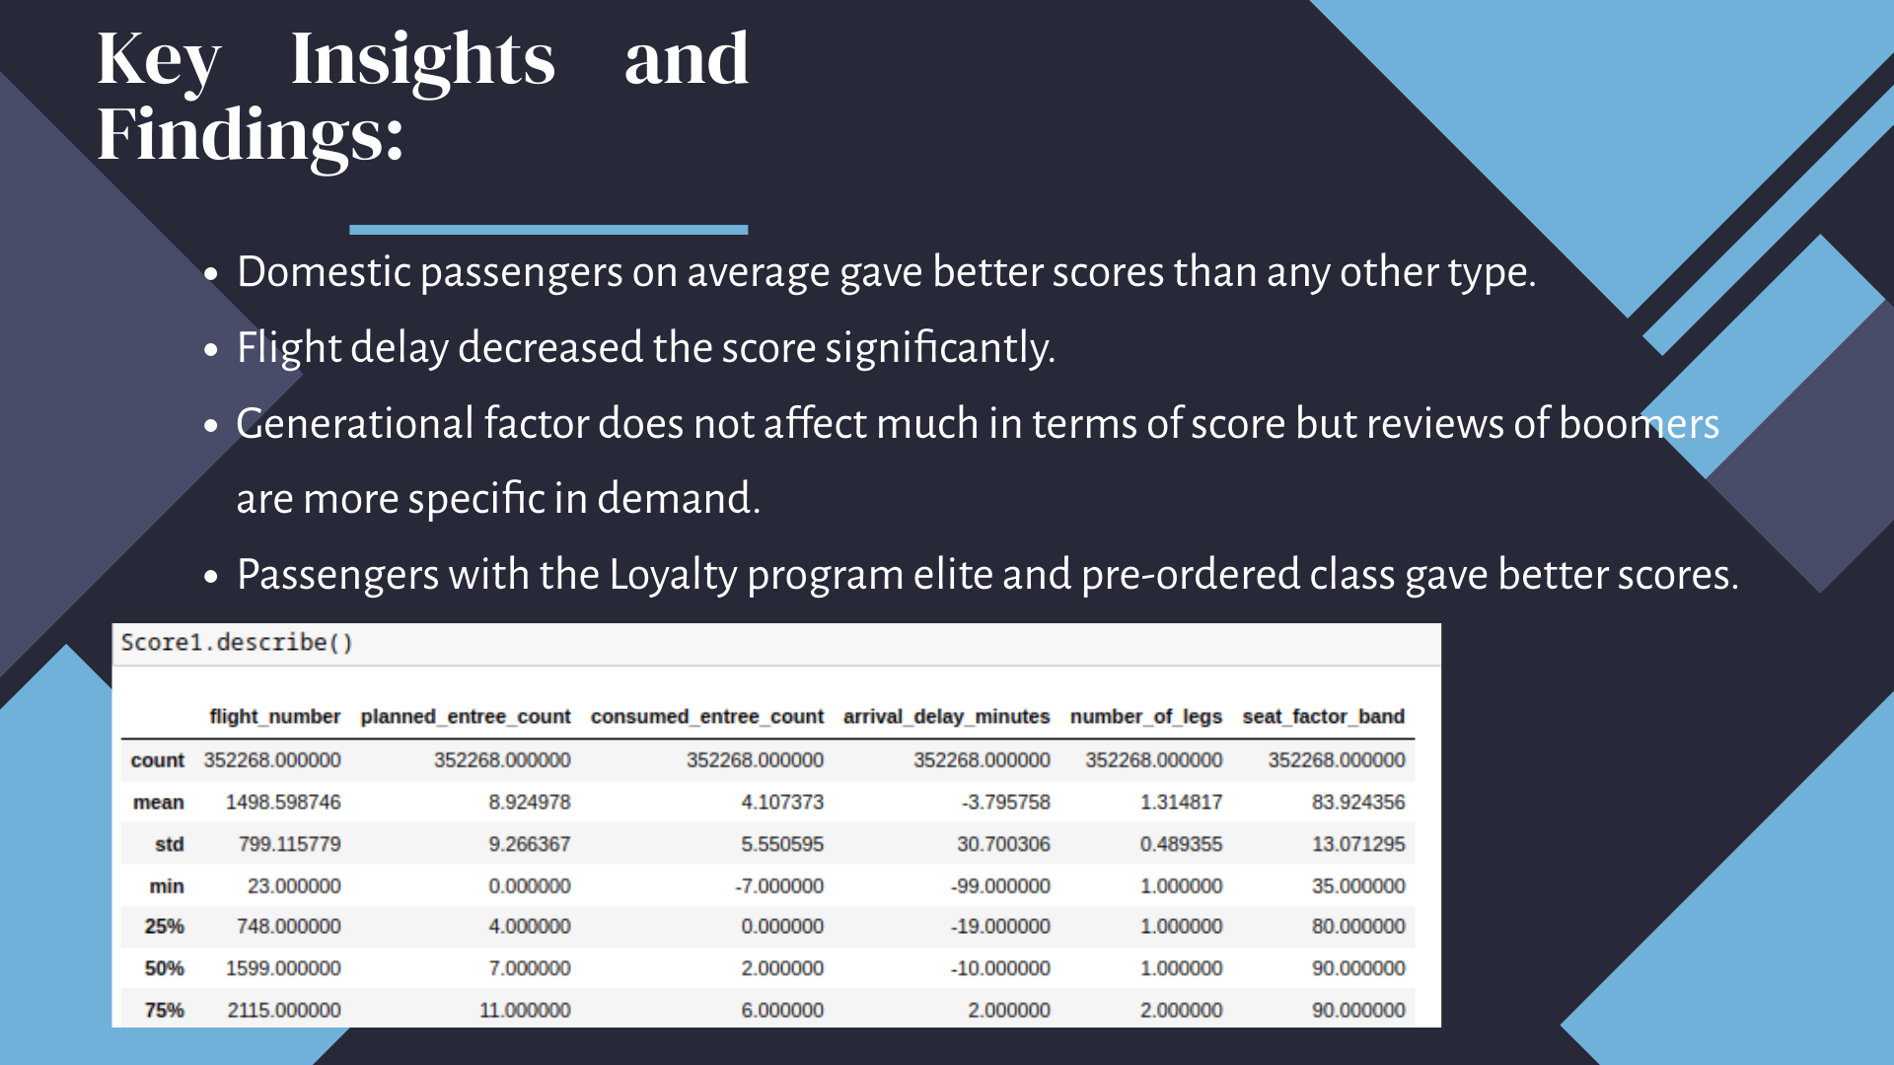

Slide 6
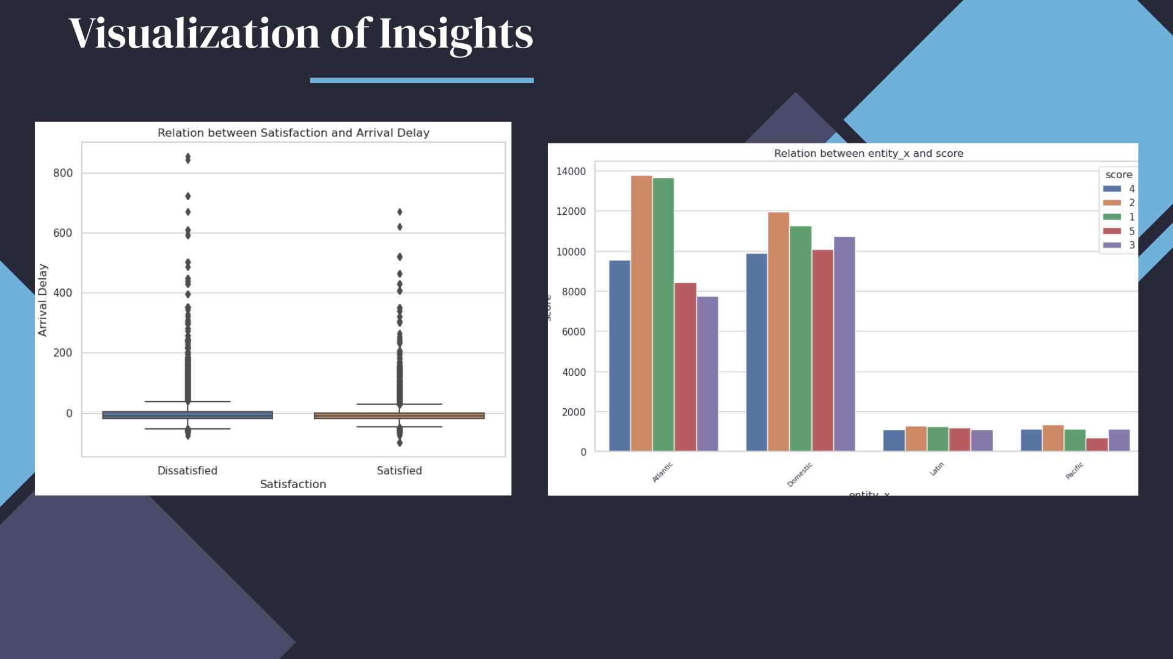

Slide 7
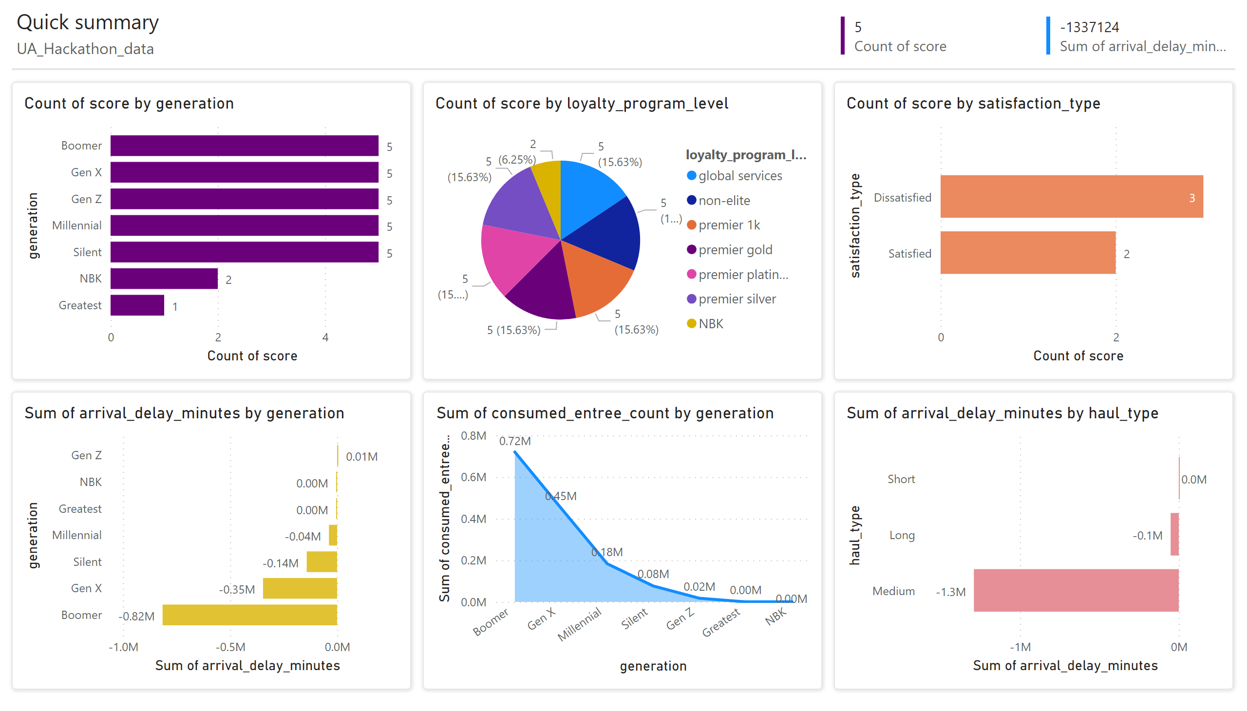
Power BI - Dashboard
Notes:
multiRowCard
No alt text provided
multiRowCard
No alt text provided
clusteredBarChart
No alt text provided
pieChart
No alt text provided
clusteredBarChart
No alt text provided
clusteredBarChart
No alt text provided
clusteredBarChart
No alt text provided
shape
No alt text provided
shape
No alt text provided
shape
No alt text provided
shape
No alt text provided
shape
No alt text provided
shape
No alt text provided
textbox
No alt text provided
textbox
No alt text provided
shape
No alt text provided
areaChart
No alt text provided

Slide 8


